Slide 1

Data Observability

Slide 2
Introduction
An organizations ability to fully understand the health of the data in their system, eliminating downtime
Organizations spend 10 to 30% of their revenue for handling data quality issues
According to Gratner, businesses lose $15 million a year due to bad data

Slide 3
Data Quality

Slide 4
Data Quality
Accuracy
Completeness
Consistency
Timeliness
Uniqueness
Validity

Slide 5
Accuracy
How many errors
Compare with reference data

Slide 6
Completeness
All fields are fully filled
Calculate % of records containing incomplete data

Slide 7
Consistency
Schema should be constant
Detect changes in schema

Slide 8
timeliness
Age of the data
Recent data tends to be accurate and consistent

Slide 9
Uniqueness
Presence of duplicates
Drop or merge duplicate records

Slide 10
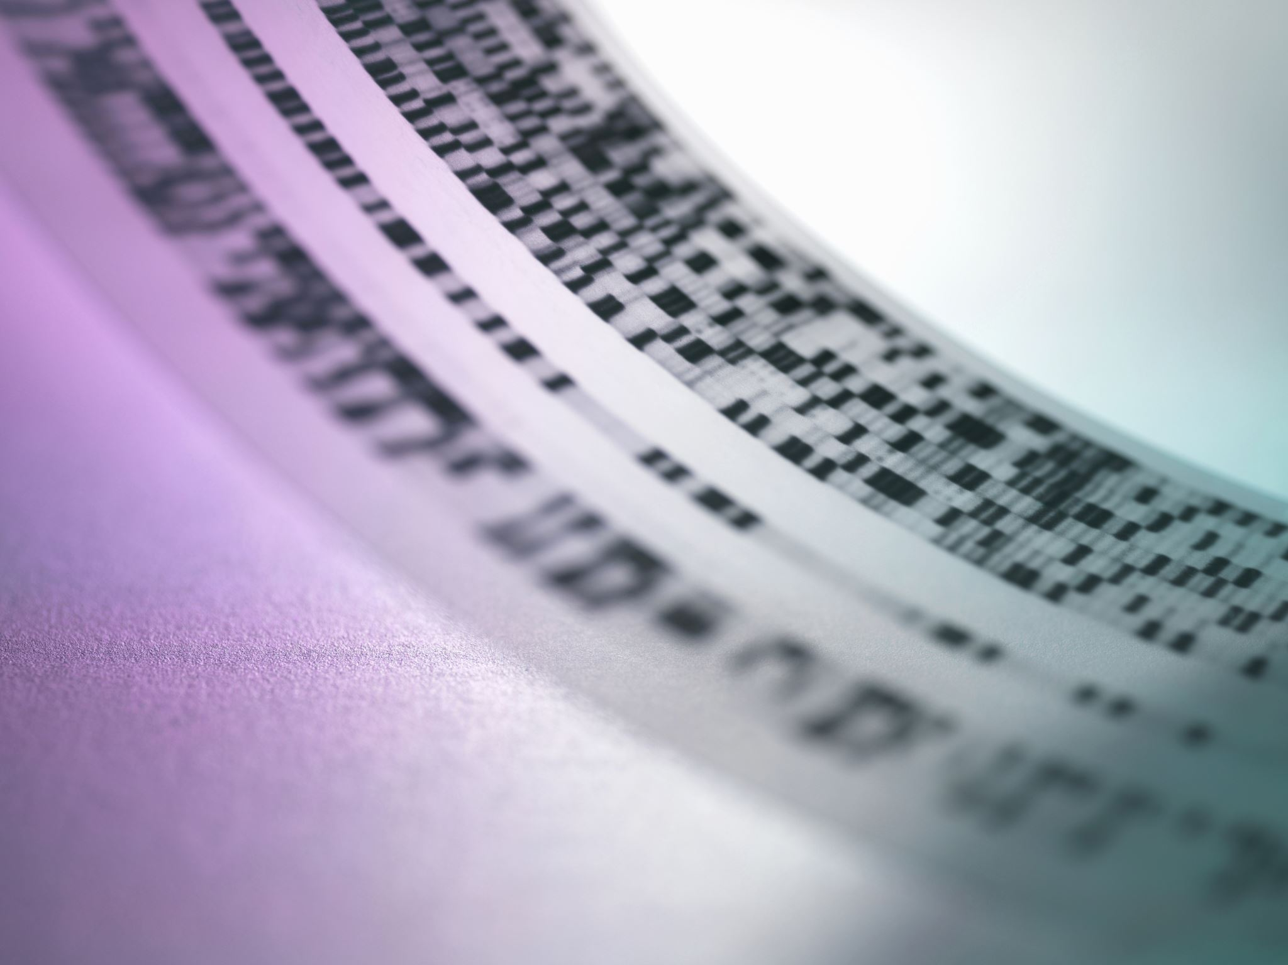
Validity
Conforms to standard formats

Slide 11
Data Observability

Slide 12
Data observability
Data quality + problem resolution
Prevents recurrent problems
Organizations can identify:
Critical datasets
End users of the data
Problems arising from the data

Slide 13
Five pillars of data observability
Freshness: how current is the data
Distribution: acceptable data range
Volume: change in volume of the data
Schema: tracks schema changes
Lineage: downstream to upstream

Slide 14
Data quality vs Data observability
Static data vs data in motion
Finding errors vs fixing systematic problems
Static rules vs dynamic rules
Data issues vs finding root causes of data issues

Slide 15
Tools
Enterprise
montecarlo
acceldata
coalesce by dbtlabs
Collibra
Bigeye
DataBuck
Open source
Soda
Great expectations

Slide 16
Screen captures of Some of the data observability tools

Slide 17
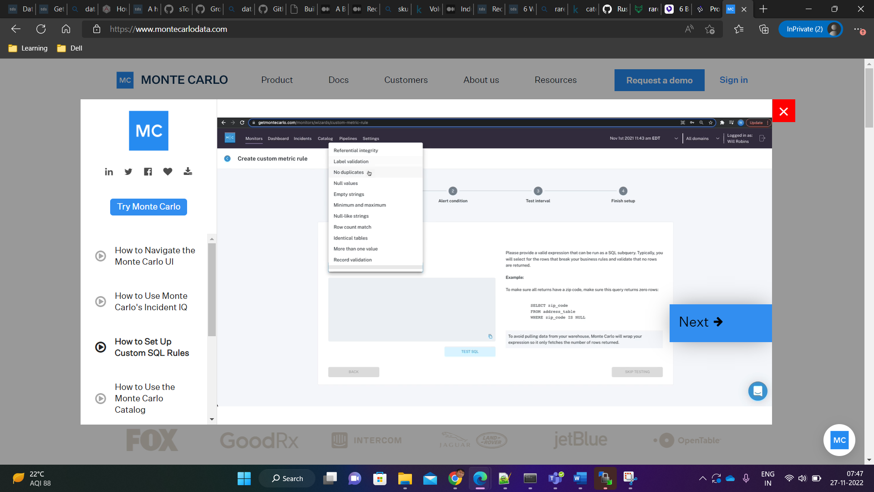

Slide 18
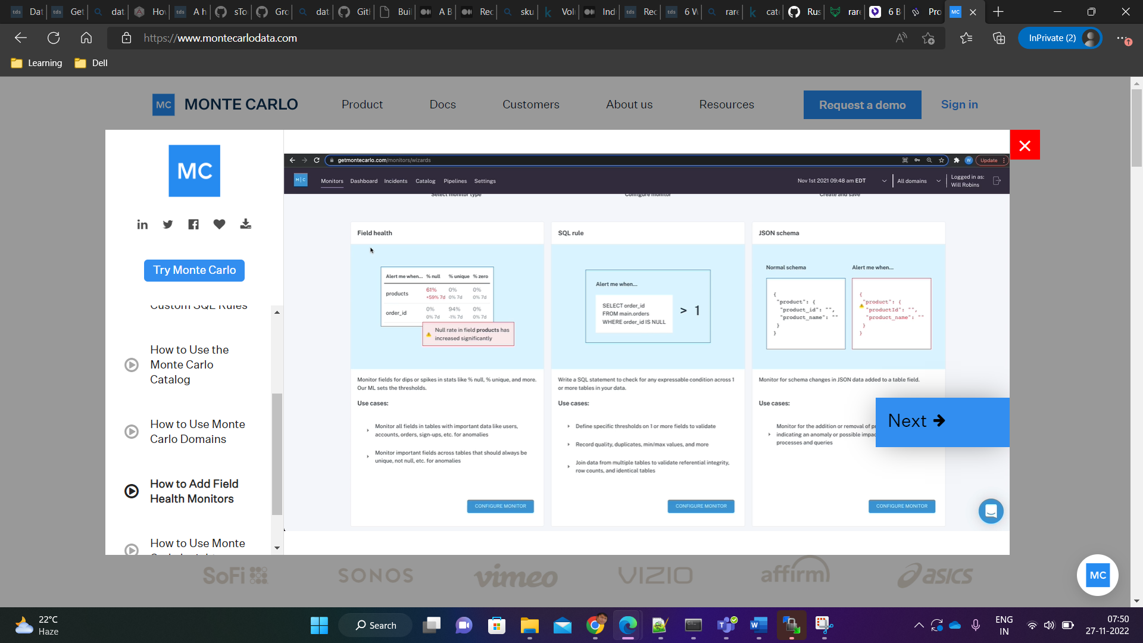

Slide 19
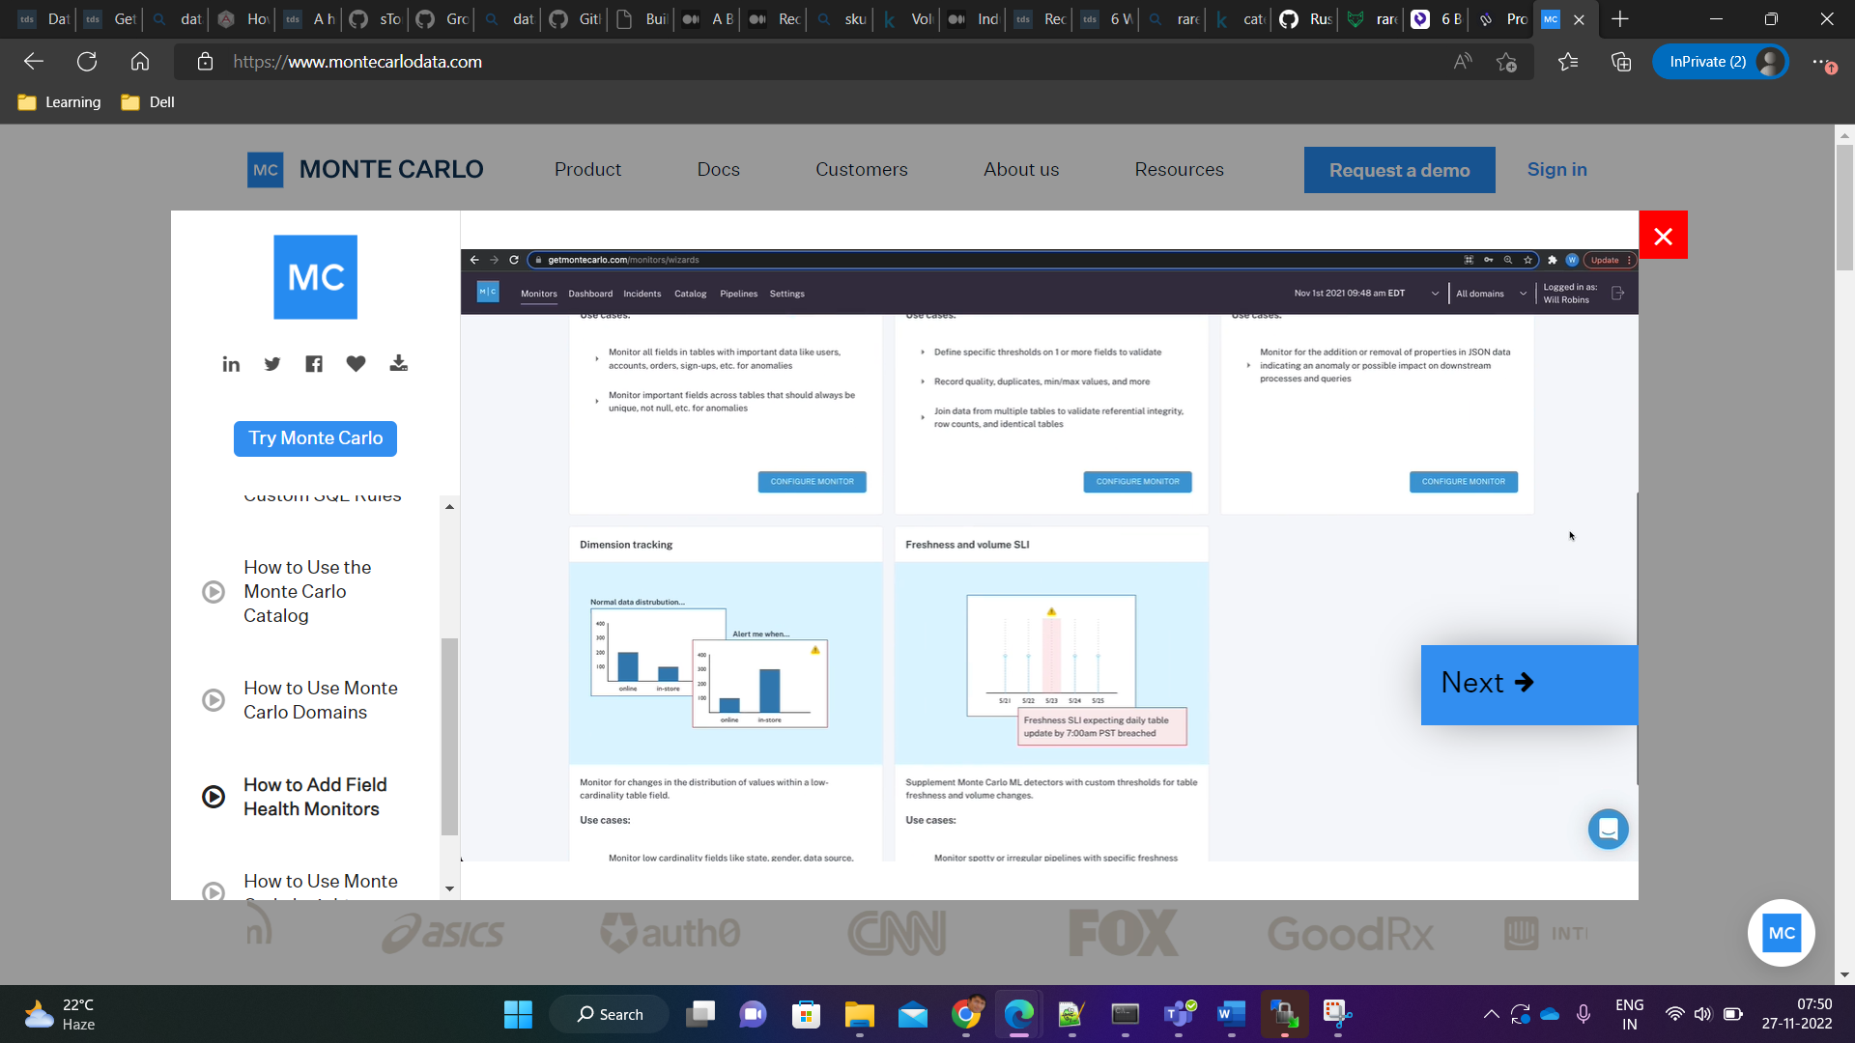

Slide 20
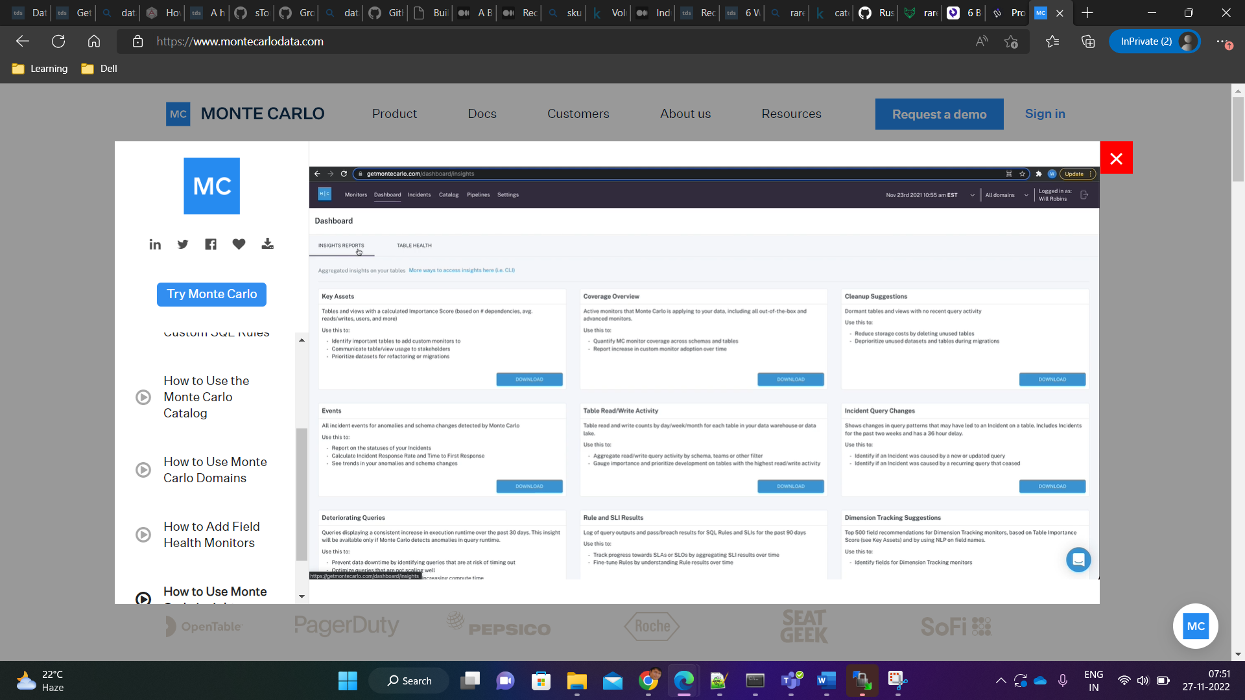

Slide 21
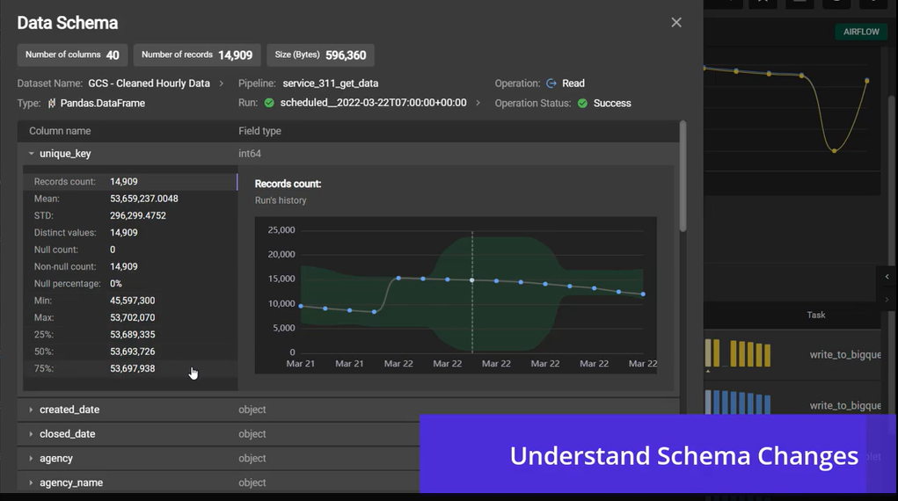

Slide 22
Parts of the system

Slide 23
Data Observability Platform
Data collector
Data Monitoring System
Data Reliability Dashboard

Slide 24

Bigeye Data Observability platform

Slide 25

Data Sources
Platforms to Support
Product or API

